Slide 1

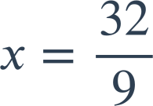
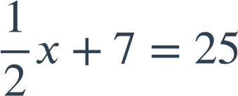
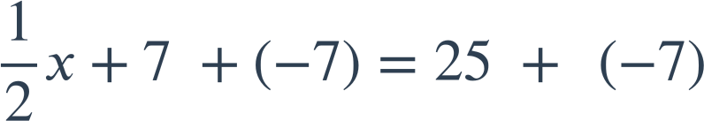
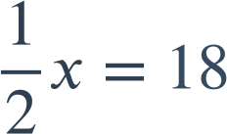

Solving two step linear equations
Task A: Solving using an additive step first
3x − 10 | = | 2
3x − 10 + 10 | = | 2 + 10
3x | = | 12
x | = | 4
2) Solve the following equations:
9x + 7 | = | 25
9x + 7 + (−7) | = | 25 + (−7)
9x | = | 18
x | = | 2
b)
9x − 7 | = | 25
9x − 7 + 7 | = | 25 + 7
9x | = | 32
a)
4 | = | 5y + 19
4 + (−19) | = | 5y + 19 + (−19)
−15 | = | 5y
y | = | −3
c)
d)

Slide 2
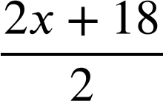


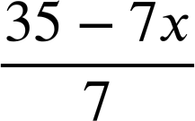

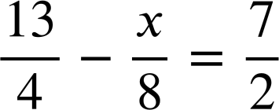

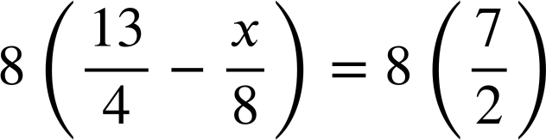

Solving two step linear equations
Task B: Multiple approaches to solving the same equation
1) Solve these equations two different ways.
a)
2x + 18 | = | 30
 | =
x + 9 | = | 15
x | = | 6
3d − 27 | = | 9
(3d − 27) | = | (9)
d − 9 | = | 3
d | = | 12
35 − 7x | = | 21
 | =
5 − x | = | 3
x | = | 2
b)
c)
2x + 18 | = | 30
2x + 18 + (−18) | = | 30 + (−18)
2x | = | 12
x | = | 6
3d − 27 | = | 9
3d − 27 + 27 | = | 9 + 27
3d | = | 36
d | = | 12
35 − 7x | = | 21
35 − 7x +(−35) | = | 21 +(−35)
−7x | = | −14
x | = | 2
2) Solve:
Mathematics in Education and Industry.
v2.2

